Slide 1
Insurrection, Death, Myth and Commemoration in Meath
A centenary reflection

Slide 2
‘We had fed the heart on fantasies The heart’s grown brutal from the fare More Substance in our enmities Than in our love’ - W. B Yeats, The Tower

Slide 3
Who died in Meath in 1920-21
Mark Clinton, Volunteer; 05/20
Seamus Cogan (1893-1920); O/C 5th Bn; 07/20
Pat McDonnell (1893-1921), I.O. 5th Bn.03/21
Thomas Hodgett, Postmaster, Navan, 02/21
Bernard Reilly, Volunteer, 12/20
Sgt P Keighery, RIC, 12/20
A.F Cowley, journalist, 11/20

Slide 4
Executed by Volunteers/IRA
Wm Gordon, 08/20
Patrick Keelan, 03/21
N. Bradley, 03-04/21
John O’Donoghue, 06/21
Sgt J Herrod, 05/21
A.N Other, 02/21
Thomas Smyth, 07/21

Slide 5
Others who died
RIC Sgt P J Carroll, from Crossakiel, killed in Kilmihil, Co Clare; buried in Kilskyre.
Volunteer Thomas Carroll, from Edenburt, Whitegate, died from pneumonia as a consequence of participating in funeral of Seamus Cogan, July 1920.

Slide 6
Commdt Seamus Cogan, d. 23/7/1920

Slide 7
Patrick McDonnell d. 23/3 1921

Slide 8
Si monumentum requiris, circumspice.........

Slide 9
Oldcastle Monument

Slide 11
Ballinlough Monument

Slide 12
Meath Chronicle 31 July 1937
Report headed ‘ Memory of Co Meath’s Martyrs’
Unveiling ceremony at Ballinlough
- Oration by My George Plunket

Slide 13
Report in Meath Chr July 24 1937

Slide 15
Platform Ballinlough July 1954

Slide 17
Ballinlough Commemoration 1954

Slide 20
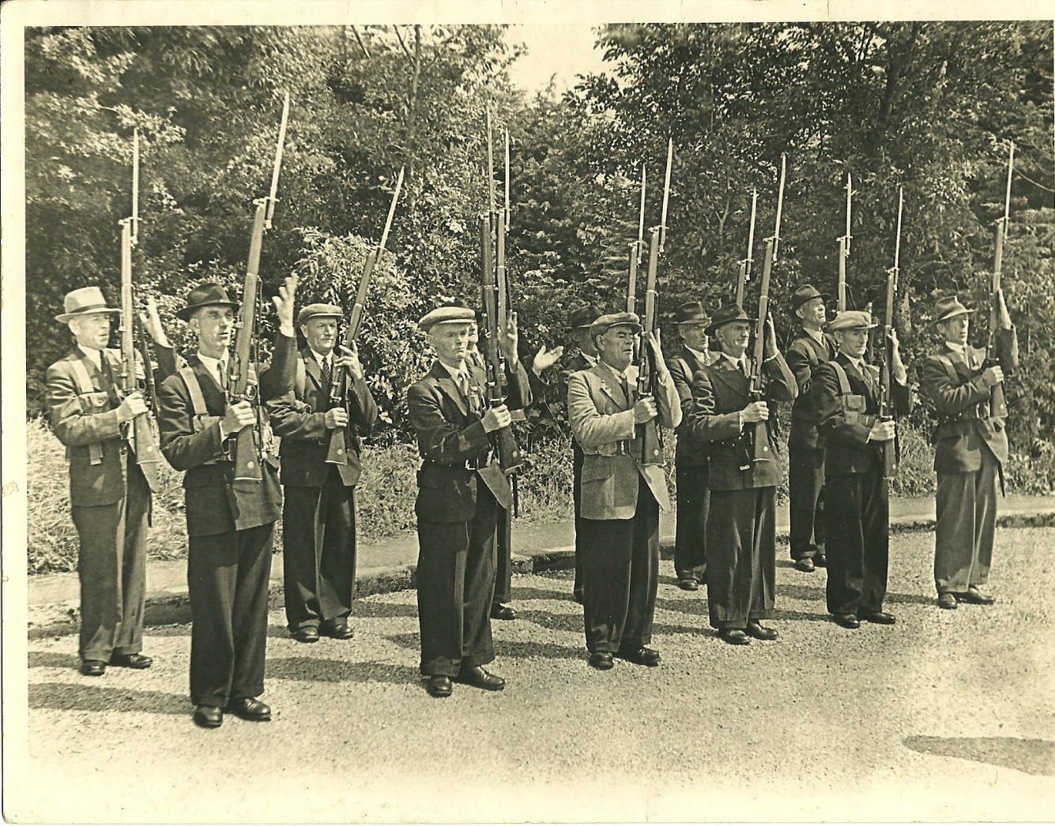
Old IRA Military Salute 1954

Slide 21
Oldcastle Monument July 1961

Slide 23
Meath Chronicle , 5 Aug 1961

Slide 24
Myth 1
We honour our War of Independence dead in Ireland more than WW1 dead
?

Slide 25
Commemoration - in Stone in Ireland www.irish war memorials.ie
Listed sites of war memorials, compiled by Michael Pegum
Lists approx 500 WW1 memorials in Ireland, about 80% in the Republic
Also lists approx 160 memorials related to W of Ind in Ireland
And a list of approx 70 Civil war memorials (several of which overlap with W of Ind list)

Slide 26
Memorials in Meath
Cemetery monuments not included
1 Civil War memorial listed – Gormanston Station (Flanagan)
1 War of Ind memorial listed (Oldcastle)
Under 1916: Ashbourne memorial
9 WW1 memorials listed

Slide 27
Myth 2
We have more than enough monuments to those who strove for Independence ?

Slide 28
Decision in 1920/21 re Kells Street-names – never put into effect

Slide 29
Alice Stopford Green 1847-1929
Born in Blackwater House, Kells, daughter of Archdeacon Stopford
Historian, humanitarian, nationalist
Friend of Casement, Griffith, Childers, Collins
Instrumental in the Howth and Wicklow Gun-running, 1914
Senator of the Irish Free State
No memorial - till December 2019

Slide 30
Unveiling of Memorial, 7 December 2019

Slide 32
A Stopford Green Grave, Dean’s Grange Cemetery

Slide 34
Myth 3
Commemorations are not inclusive and do not promote respect for different views/traditions ?

Slide 35
Ballinlough 1954
Address by Seamus Finn, 3rd Brigade Adj, Old IRA – acceptance of flag presented by Mr Walsh, ex-British army, Navan
Partcipation by both pro-Treaty and anti- Treaty combatants
Inclusive tone of remarks by Fr J Cogan – positive comments re attitude of British army officer in 1920

Slide 36
2017-19 Research on Lt A.H.Ball
Establishment of contact with family of Lt (later Major Ball)
Exchange of correspondence with grandnephew, Mr David Redman.
Invitation to commemoration ?

Slide 37
2nd Lt A.H. Ball Service Record

Slide 38
Family Tree in Ancestry.com website

Slide 40
Extract from Letter of Mr D. Redman

Slide 41
Thank You

